Slide 1
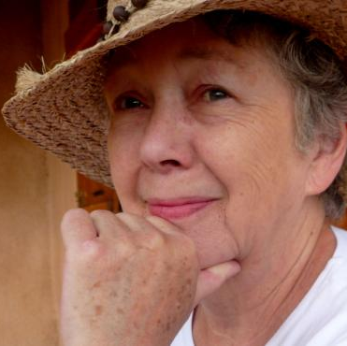
Ann Barbara Waswo
17 May 1940 –
21 September 2020

Slide 5
